Slide 1
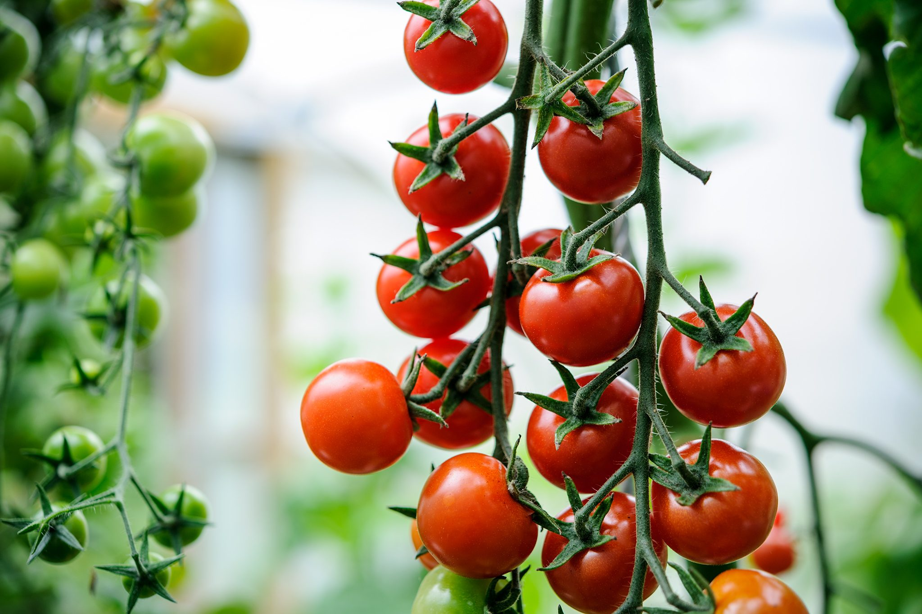
PROJECT ON ENTREPRENEURSHIP DEVELOPMENT OF TOMATO MANUFACTURING FACTORY
GUIDED BY:- PROJECTED BY:-
DR. APURBA GIRI MR.SUMAN KUMAR DAS
(ASSISTANT PROFESSOR AND HOD) ROLL:- 0478
AYAN MONDAL B.VOC(FOOD PROCESSING,6TH SEM)
(ASSISTANT PROFESSOR) DEPT. OF NUTRITION
DEPT. OF NUTRITION MUGBERIA GHANGADHAR MAHAVIDYALAYA
MUGBERIA GHANGADHAR MAHAVIDYALAYA

Slide 2
.

Slide 3
INTRODUCTION:- Tomato is the edible berry of the plant solanum lycopersicum, commonly known as the tomato plant. The species originated in Western South America, Mexico,and Central America.The Mexican Nahuatl word tomato,from which the English word tomato Derived. Top Tomato Producing States in India:- The major Tomato producing states in the country are Andhra Pradesh, Madhya Pradesh, Karnataka, Gujrat, Odisha, West Bengal, Maharashtra, Chhattisgarh, Bihar, Telengana, Uttar Pradesh, Haryana and Tamil Nadu. These states are account for 91% of the total production of the country.

Slide 4
TOMATO MANUFACTURING REQUIRED EQUIPEMENT RAW MATERIALS MACHINERY INVESTMENT CUSTOMERS AREA MANPOWER PROFIT LICENSE MARKET STRATEGY

Slide 5
KNOW THE BUSINESS
DEMAND
SUPPLY
PRICE
QUANTITY
QUALITY

Slide 6
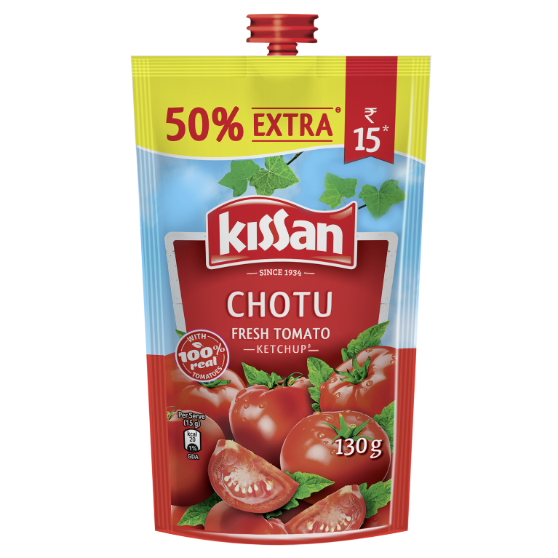
TYPES OF TOMATO PRODUCT
TOMATO KETCHUP
TOMATO JAM
TOMATO JELLY
TOMATO SAUCE
TOMATO JUICE
TOMATO PASTE

Slide 7
RAW MATERIALS
CLEAN AND RIPE TOMATO
SUGAR
SALT
ACETIC ACID(glacial)
ONION
GARLIC
SODIUM BENZOATE
AND SPICE POWDER
PACKAGING MATERIALS(BOTTLES/METAL CAN/POUCH)

Slide 8
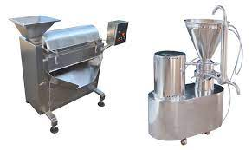
MACHINERY
ULTRASONIC WASHER
STAINLESS STEEL KETTLES AND TANKS
DICERS
MICRO CUT MACHINE
PH METERS
STORAGE TANK
REFRACTOMETERS
BUCKETS
SPOONS
SEALING MACHINE
STAMPING MACHINE

Slide 9
PROCESS
Raw Tomato Storage
Cleaning and Sorting
Skin/Seed Removal
Evaporator
Refining
Heat Treatment
90°C
Formulation
Pasteurization
60-99°C
Pasteurization
Packing Tomato Paste
Packing Ketchup/Puree
85°C

Slide 10
INVESTMENT
TOTAL INVESTMENT :- I want to start a small-scale tomato ketchup manufacturing firm, the total investment will be between Rs.2 lakh and Rs. 3 lakh.

Slide 11
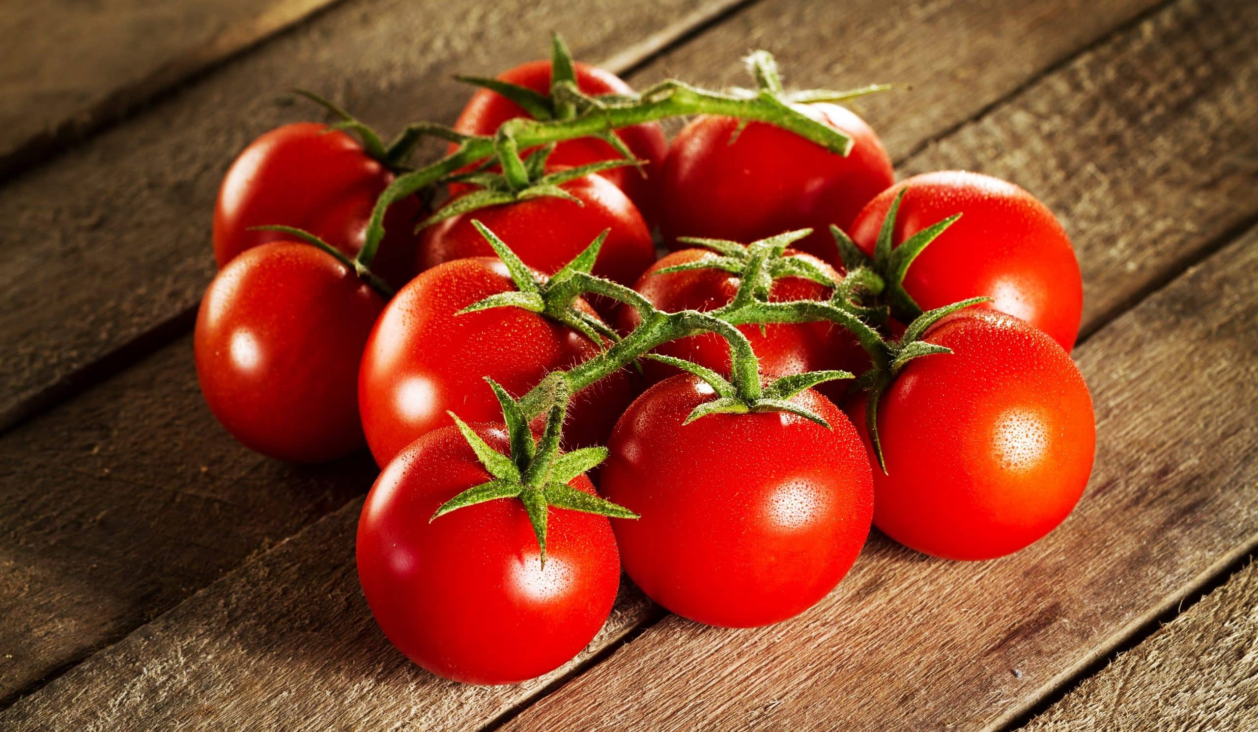
PRODUCTION COST
148g amount of tomato can give us 100g ketchup.
Production cost-7 Rs.
Product cost – 15 Rs.
And the wastage part of tomato like (peel,seed) are used cosmetics prodution,feed ingredients for animal feeding. these are highly rich in fiber and lycopene.

Slide 12
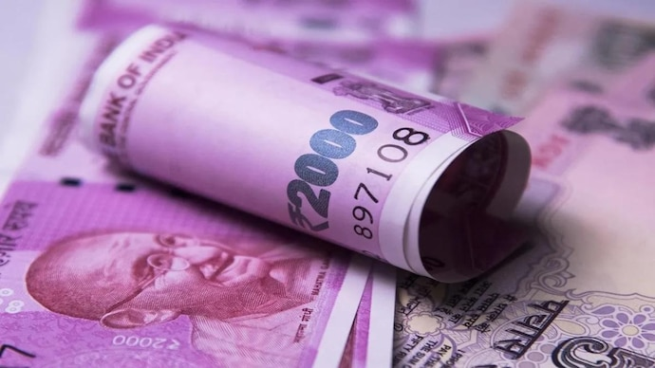
PROFIT
DEPENDING ON PRODUCTION & BUSINESS MODEL
RETURN:- 55-60%

Slide 13
AREA 800 SQ FT MAN POWER 2-3 LABOURS

Slide 14
LICENCE
NOC FROM STATE POLUTION CONTROL BOARD
GST
FSSAI
TRADE LICENSE
REGISTRATE FOR A TRADEMARK
REGISTRATION OF BUSINESS LICENSE.

Slide 15
TARGET CUSTOMER
WHOLESALERS
DISTRIBUTORS
RETAILERS
STORES
ONLINE PLATFROM
RESTURENT

Slide 16
MARKETING STRATEGIES
FIRSTLY, PERSONAL SELLING
SECOND, TEST METHOD
THIRD, ADVERTISING
FOURTH, SALES PROMOTION
FIFTH, DIRECT MARKETING
LASTLY, PUBLICITY

Slide 17
